Slide 1
Markov Chain for Slotted Aloha
CSMA

Slide 2
1. Markov Chain for Slotted Aloha
Slotted Aloha
Time is divided into slots of one packet transmission period
If a node has packet to send => it waits until the start of the next slot to send it.
If have only one node send packet during a slot, the transmission is successful. Otherwise collision
+ Node becomes backlogged node
+ Each backlogged node waits for random time before retransmiting

Slide 3
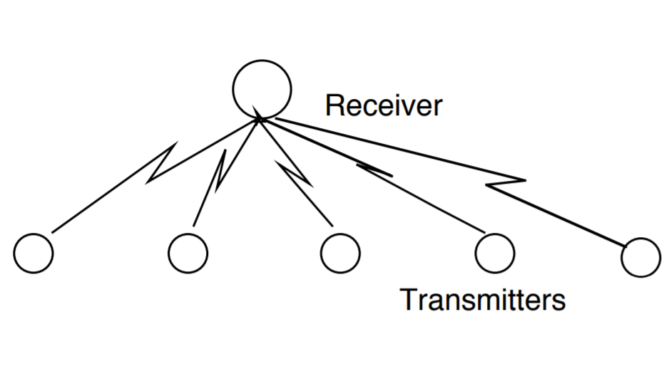
Slotted Aloha
Assumptions:
-Single receive, many transmitters
-Poisson arrival rate λ
-Transmitters send broadcast
to notify about their choice
-Receiver immediately feedback
+Idle (0)
+Success (1)
+Collision (e)

Slide 4
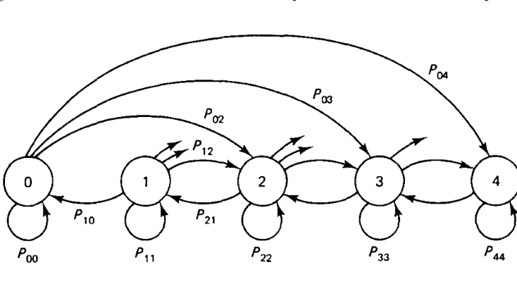
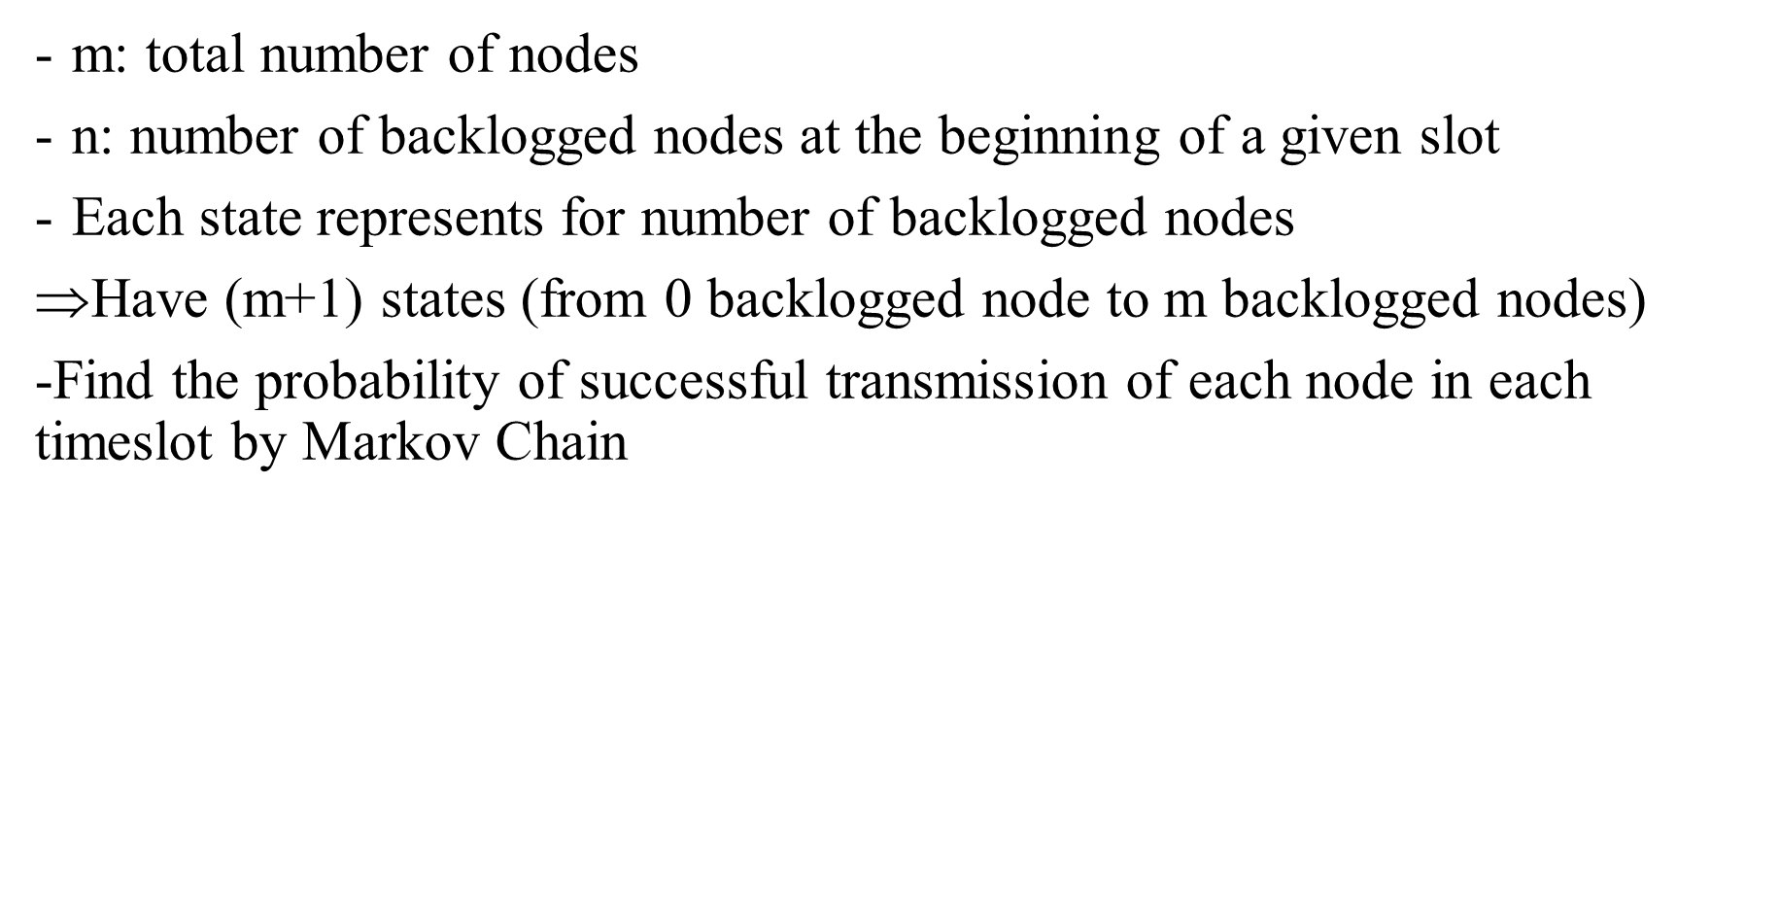
Markov Chain for Slotted Aloha
m: total number of nodes
n: number of backlogged nodes at the beginning of a given slot
Each state represents for number of backlogged nodes
Have (m+1) states (from 0 backlogged node to m backlogged nodes)
-Find the probability of successful transmission of each node in each timeslot by Markov Chain

Slide 5
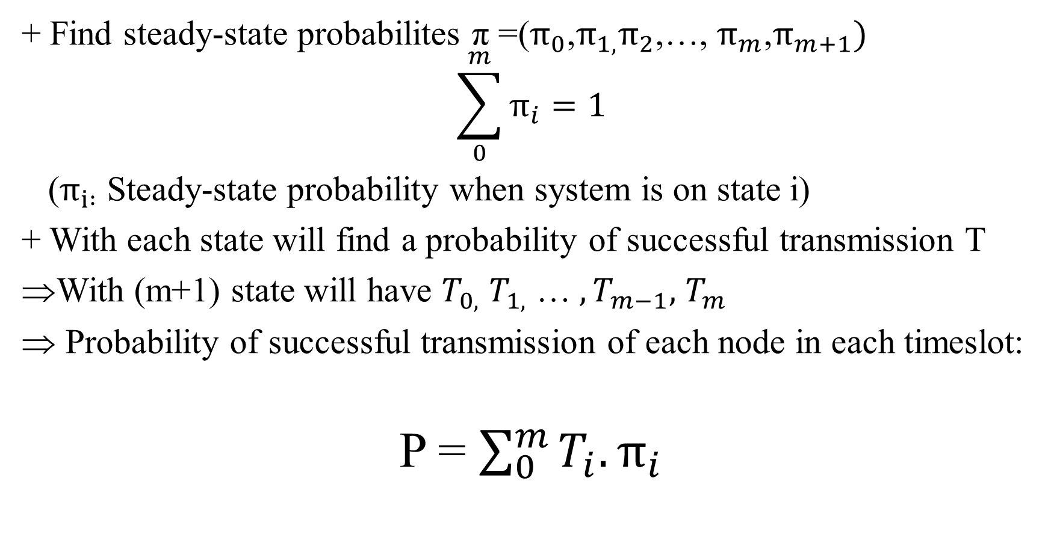
Markov Chain for Slotted Aloha
+ Find steady-state probabilites π =($π_{0}$,$π_{1,}π_{2}$,…, $π_{m}$,$π_{m+1})$
$$\sum_{0}^{m}{π_{i}=1}$$
($π_{i :}$ Steady-state probability when system is on state i)
+ With each state will find a probability of successful transmission T
With (m+1) state will have $T_{0,}$ $T_{1,}$ … $,T_{m−1},$ $T_{m}$
Probability of successful transmission of each node in each timeslot:
P = $\sum_{0}^{m}{T_{i}.π_{i}}$

Slide 6
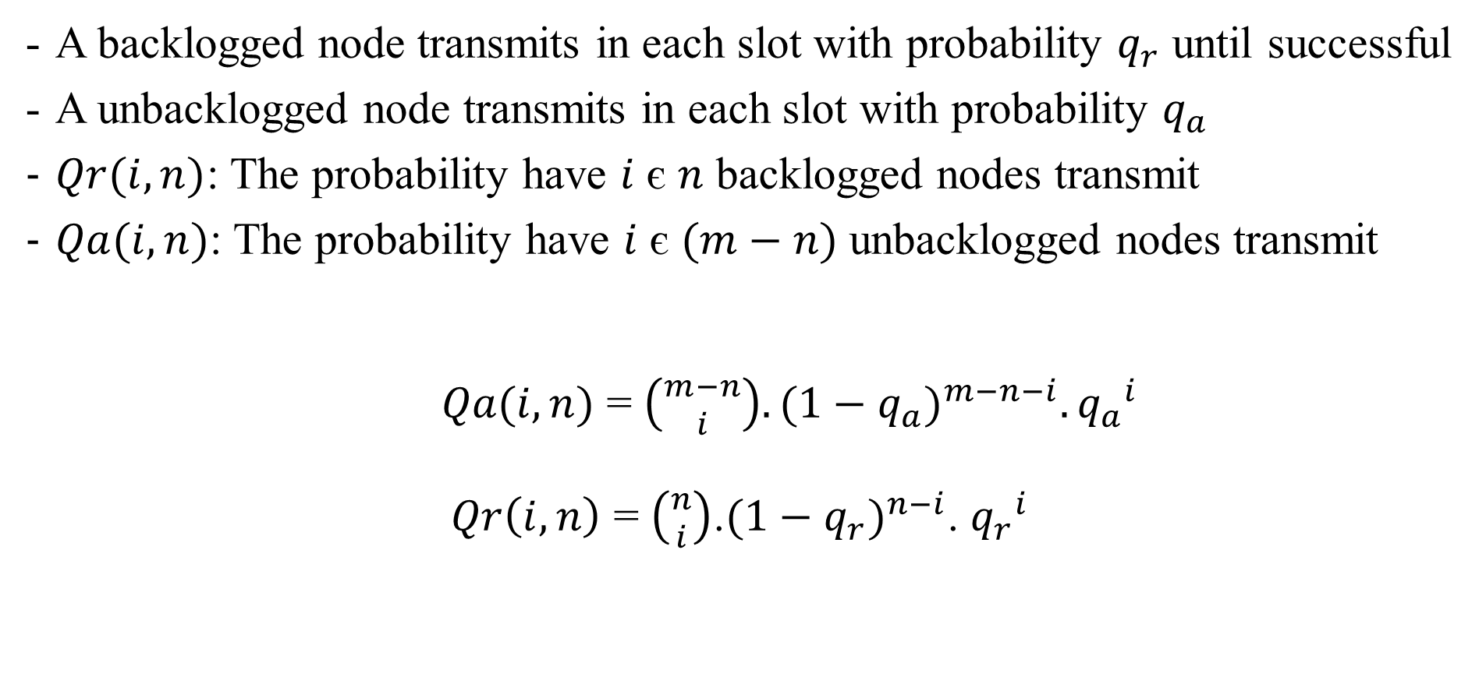
Find steady-state vector π
A backlogged node transmits in each slot with probability $q_{r}$ until successful
A unbacklogged node transmits in each slot with probability $q_{a}$
$Qr(i,n)$: The probability have $i$ є $n$ backlogged nodes transmit
$Qa(i,n)$: The probability have $i$ є $(m−n)$ unbacklogged nodes transmit
$Qa(i,n)$ = $\left({m−n \atop i}\right).{(1−q_{a})}^{m−n−i}.{q_{a}}^{i}$
$Qr\left(i,n\right)$ = $\left({n \atop i}\right)$.${(1−q_{r})}^{n−i}$. ${q_{r}}^{i}$

Slide 7

Markov Chain for Slotted Aloha
The state transition probability from state $n$ to state $( n$+$i$)
P($n,n$+$i$)= $\left\{\begin{aligned}Qa\left(i,n\right) 2≤i≤(m−n) \\ Qa\left(1,n\right).\left[1−Qr\left(0,n\right)\right] i=1 \\ Qa\left(1,n\right).Qr\left(0,n\right)−Qa\left(0,n\right).\left[1−Qr\left(1,n\right)\right] i=0 \\ Qa\left(0,n\right).Qr\left(1,n\right) i=−1 \end{aligned}\right.$

Slide 8
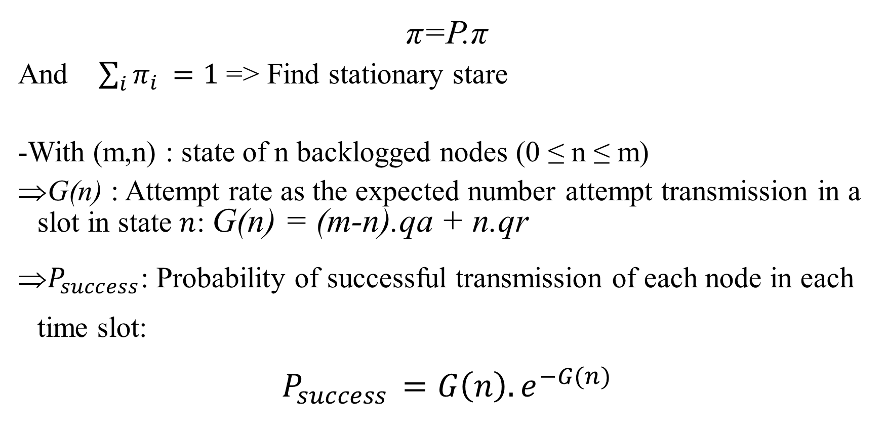
A stationary state distribution must satisfy the condition
π=P.π
And $\sum_{i}{π_{i }=1}$ => Find stationary stare
-With (m,n) : state of n backlogged nodes (0 ≤ n ≤ m)
G(n) : Attempt rate as the expected number attempt transmission in a slot in state $n$: G(n) = (m-n).qa + n.qr
$P_{success}$: Probability of successful transmission of each node in each time slot:
$$P_{success }=G\left(n\right).e^{−G(n)}$$

Slide 9
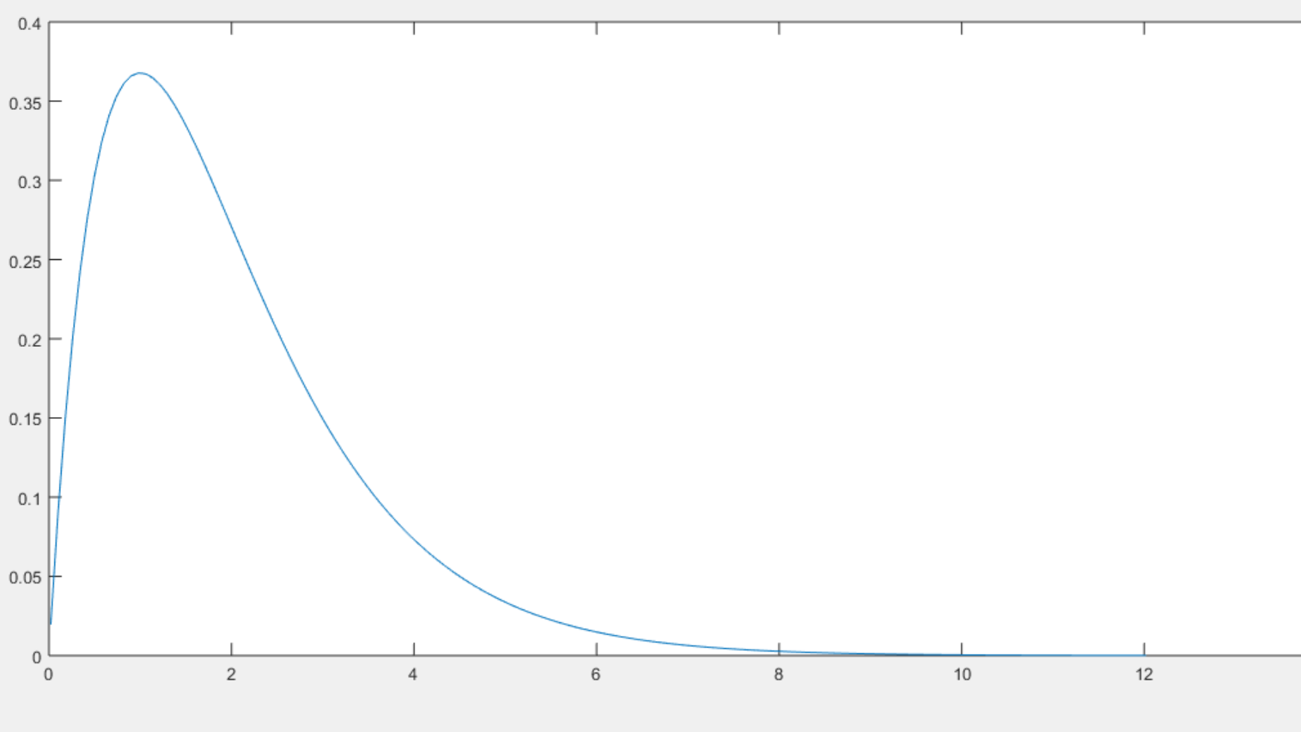
Throughput is probability of successful transmission in a slot

Slide 10
CSMA
-Nodes listen to the channel before they start transmission
Channel idles => Transmit
Channel busy => Wait (join backlog)

Slide 11
Transmission Options
+ 1 persistent + Non persistent
Nodes sense
Nodes sense
Channel
Channel
Channel busy
Wait random time
Channel busy
Channel idle
Channel idle
Transmit
Transmit

Slide 12
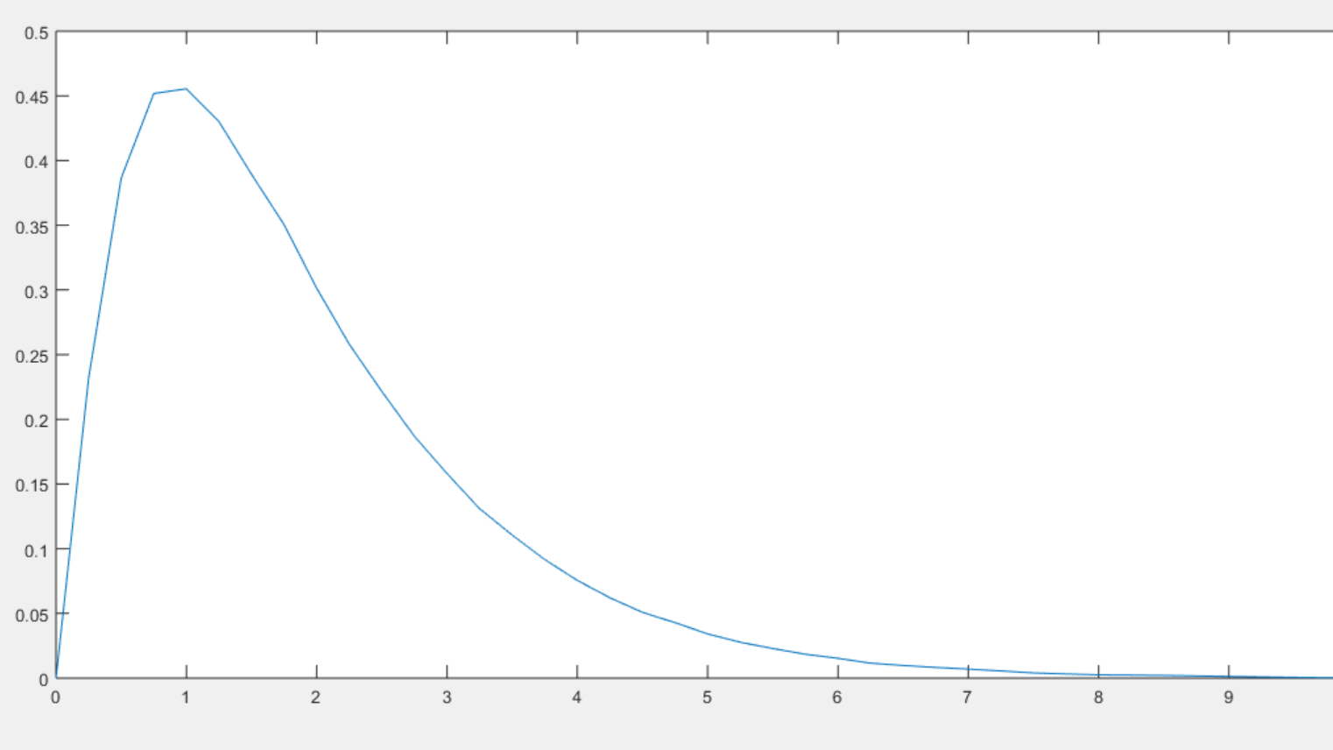
1- persistent
.

Slide 13
Transmission Options
P-persistent
Nodes sense
Channel
Channel busy
Wait next slot
Channel idle
Channel idles
Probability to transmit?
Wait next slot/ ≥ P
Sense Channel
Random time to sense/ channel busy
Transmit/ ≤P

Slide 14

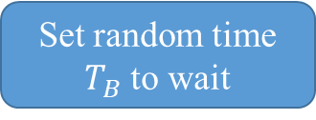
CSMA/CD
If a node is transmitting it will monitor for collision during the transmission by comparing transmitted data with received data
Start
Nodes sense channel
Wait $T_{B}$ time
Send data/ channel idle
Stop transmission/ detect collision
Set random time $T_{B}$ to wait
Detect collision?
Transmit successful/No collision

Slide 15
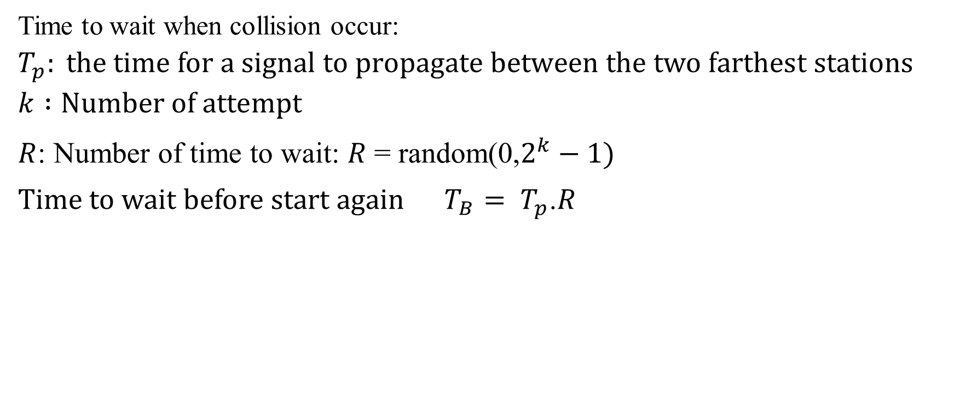
CSMA/CD
Time to wait when collision occur:
$$T_{p}: the time for a signal to propagate between the two farthest stations$$
$$k :Number of attempt$$
$R$: Number of time to wait: $R$ = random(0,$2^{k}−1)$
Time to wait before start again $T_{B}= T_{p}$.$R$

Slide 16
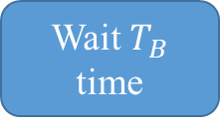

CSMA/CA
Start
.
Nodes sense channel
Channel Idle
Wait $T_{B}$ time
Send RTS
Set ramdom time $T_{B }$to wait
Receive CTS?
Transmit successfully/ Received CTS

Slide 17
CSMA/CA
Prevent collision before they happen
A spectrum divided into N bands
Assume that RTS messages have the same time duration for all users
When have idle period before transmitting, randomly chooses one band over the N to send a permission request message (RTS) to the destination node
It waits for receiving an authorization message (CTS) from the destination node before transmitting data
=> Collision can occur with RTS => wait random time and start again

